Slide 1
Molecular Phylogenetics of some endangered turtle species
Natalia Morozova

Slide 2
Data
Genbank
4 genes, 2 mitochondrial (12S, 16S) and 2 nuclear (COI and RAG-1)
9 species:
5 sea turtles, 2 terrestrial, 1 freshwater and 1 aquasemiatic
For several sequences for the same gene and species consensus sequence was made
Molecular phylogenetics of some endangered turtles reveals new close genetic relationships (2023) DOI:10.26577/ijbch.2023.v16.i1.02

Slide 3
Methods
MAFFT and MUSCLE for alignment
NJ: phylip, F84, alpha=0.5
ML: IQTree
Bayesian: MrBayes

Slide 4
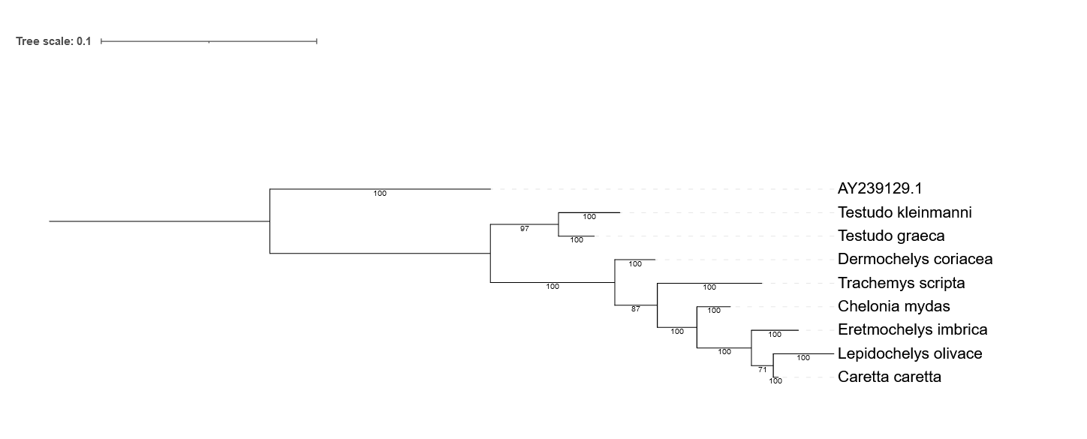
Results
12S Bayesian
Early differentiation of terrestrial turtles

Slide 5
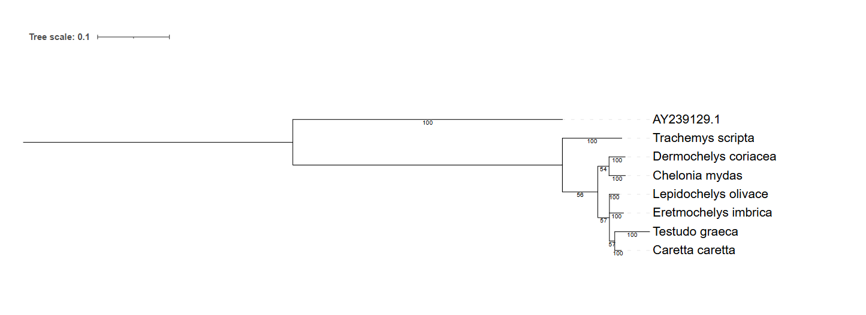
16S
Separation of Trachemys scripta (American freshwater turtle)

Slide 6
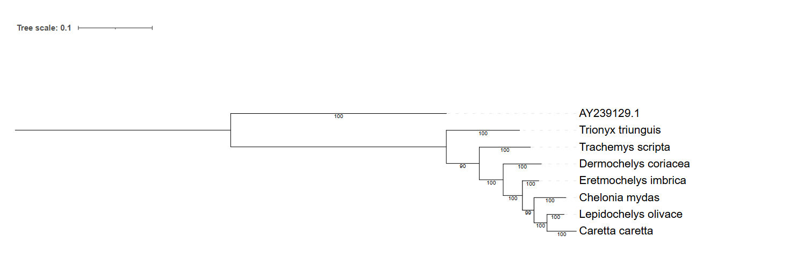
COI
Tryonix triunguis’s main area is Africa

Slide 7
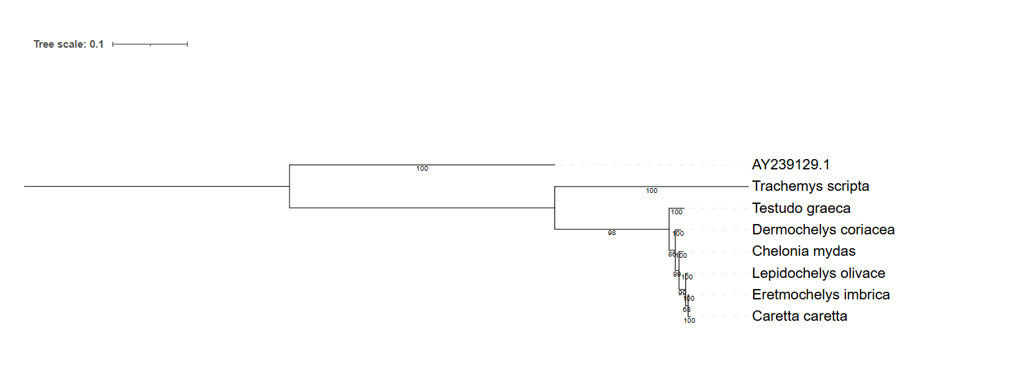
RAG-1

Slide 8
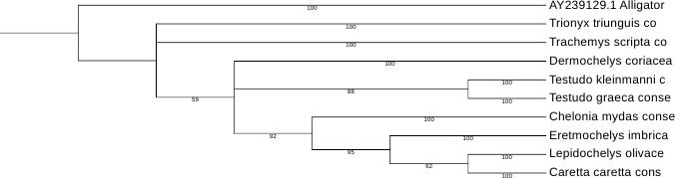
Bayesian tree for supermatrix of 4 genes

Slide 9
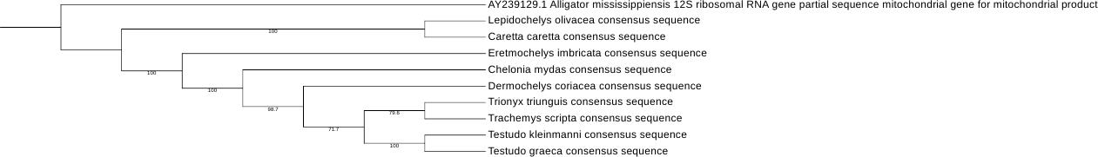
Maximum likelihood tree for supermatrix
(African and American turtles as well as terrestrial diverge after the Chelonidae)

Slide 10
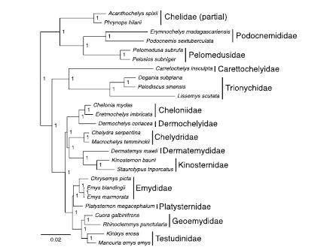
Phylogenomic analyses of 539 highly informative loci dates a fully resolved time tree for the major clades of living turtles (Testudines)
(2017)
(https://doi.org/10.1016/j.ympev.2017.07.006)

Slide 11
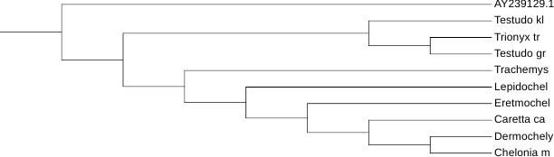
NJ supermatrix tree

Slide 12
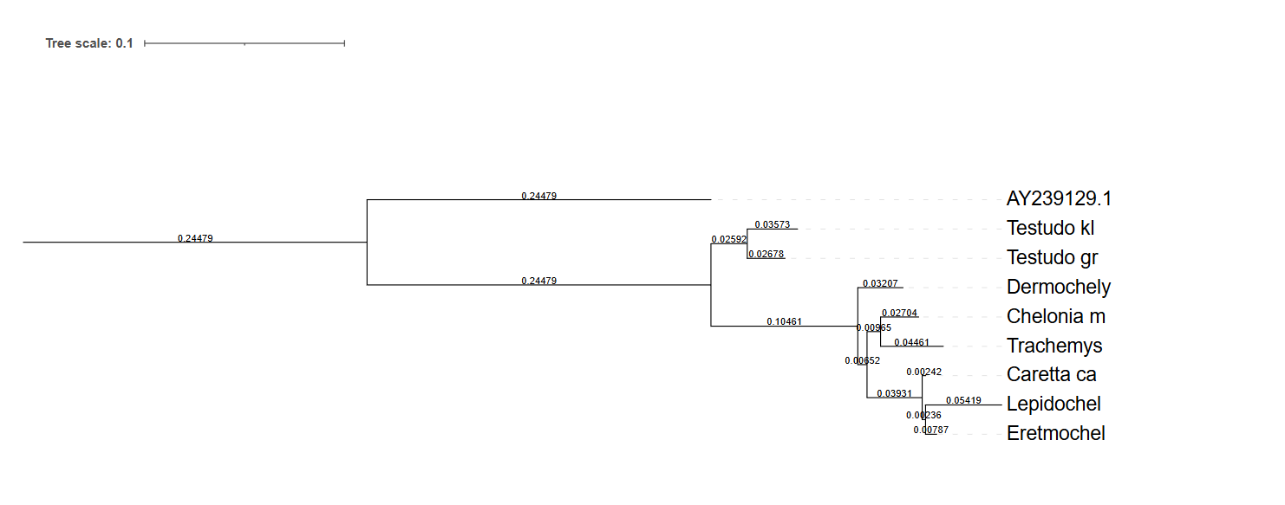
NJ 12S tree (similar with Bayesian)

Slide 13
Thank you for your attention!

